Slide 1
Smart Home Device (Team 36)
Advisors: Professor Godrich Members: Neil Surti Imad-Uddin Siddiqui
Samuel Ramrajkar Thorson Dai Austin Su

Slide 2
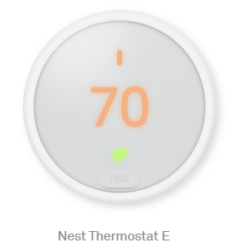
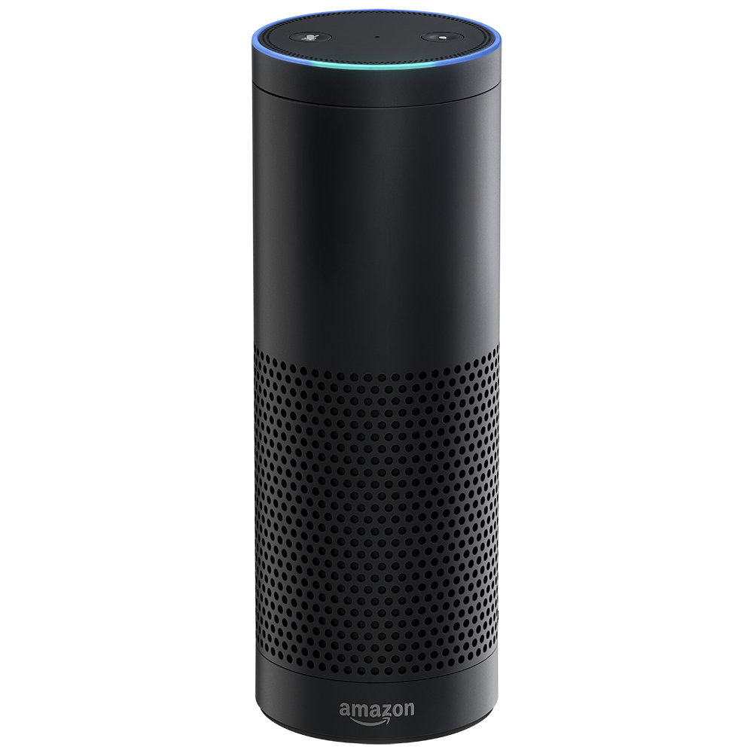
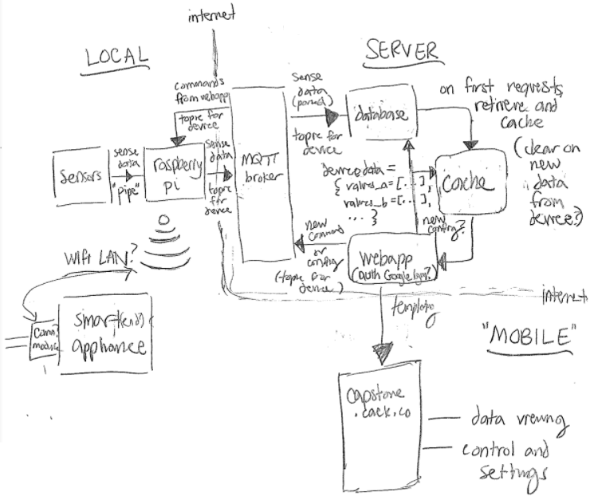
Background
Current Smart Home devices like Alexa and Nest
Expensive
Proprietary
Limited application
Our goal is to create a smart home device platform which is
Cheap and accessible
Easily integratable
Equipped with sensors, the Smart Home Device will gather data on room conditions. This data is then sent to a server, which runs a web-app for control settings and data visualization.

Slide 3
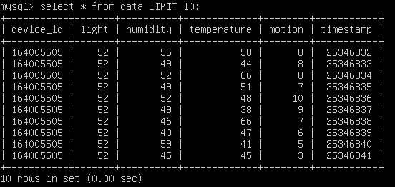
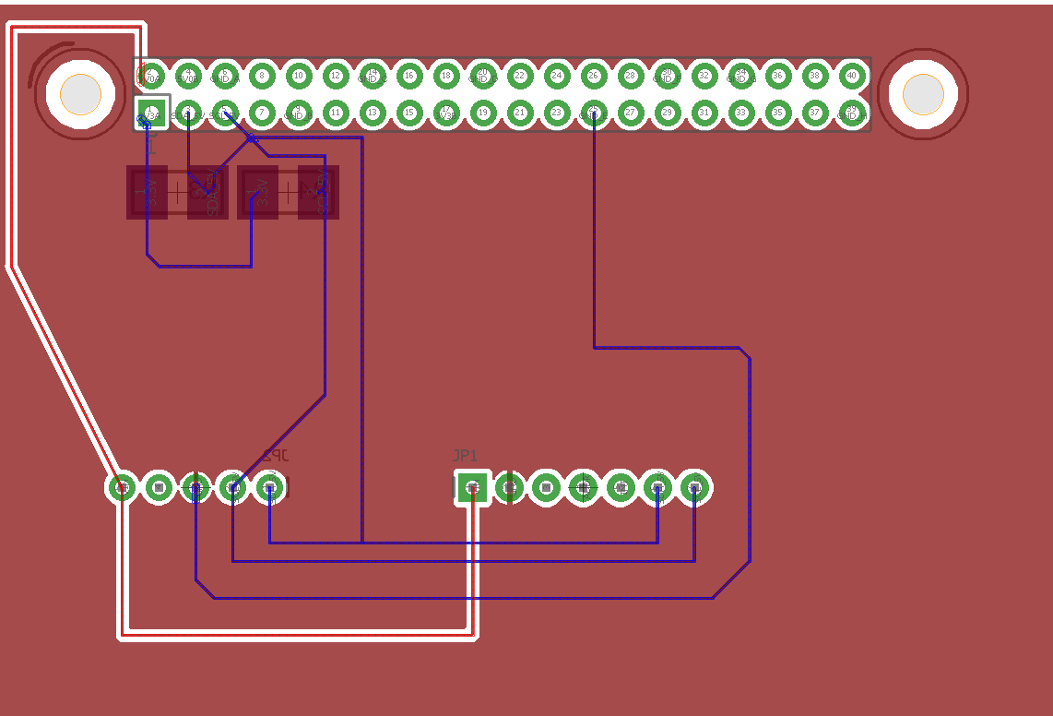
Task Allocation
Hardware Team (Neil Surti & Imad-Uddin Siddiqui)
Responsible for integrating all sensors on Raspberry Pi and matters pertaining to the physical device.
Software Team (Thorson Dai & Austin Su)
Responsible for server administration, web-app development and device-server communications.

Slide 4

...for a home, not the universe.
The project scope involves the following:
Setting up sensors with a Raspberry Pi for temperature, humidity, lighting, and motion events [COMPLETED - FEBRUARY]
Sending and receiving sensor and control data between the web-app server and the “Smart Home Device”. [COMPLETED - MARCH]
Provide control hooks and signals to control other smart home devices and appliances (Hysteresis). [IN PROGRESS]

Slide 5
CHALLENGES
Getting the I2C sensors to detect on the raspberry PI
Sensors burning out (BME680 and Si7021)
Integrating the sensor output to the javascript file that connects to server (Piping)
Issue with RUWireless since the ports are blocked and the device isn’t able to have a constant connection

Slide 6
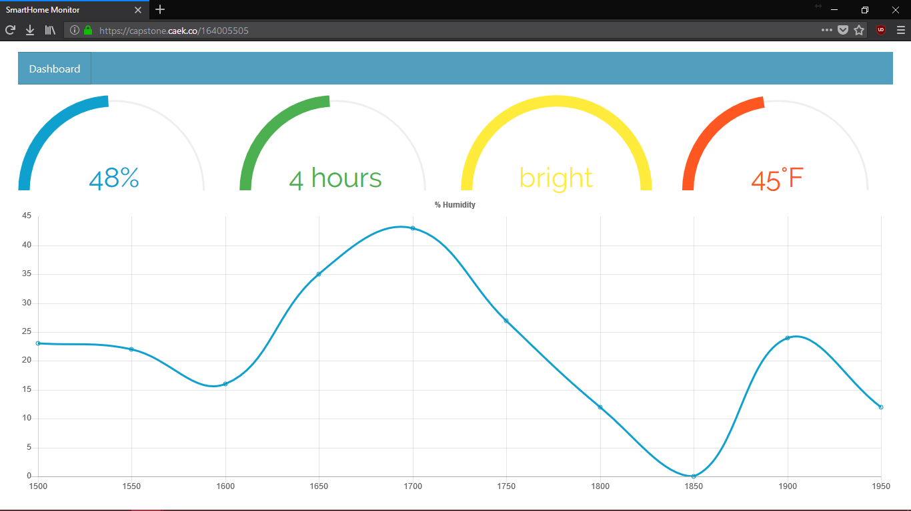
Current Progress

Slide 7
Cost of mass production
Cost of our prototype would be about $85 with the Raspberry PI 3 being most expensive
Price can be reduced by buying sensors in mass and using cheaper microcontroller (i.e. Raspberry Pi Zero W)
By using a cheaper microcontroller and buying sensors in bulk estimate the cost to be about $31.99
Much cheaper than other current smart home devices

Slide 8
Questions?

